Slide 1
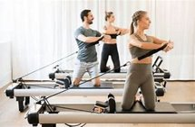
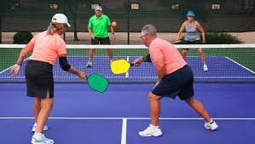
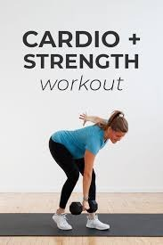
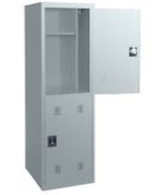
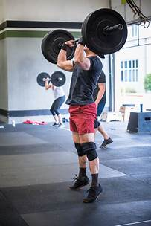
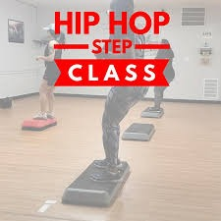
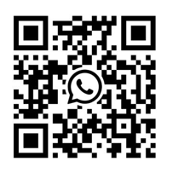
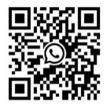
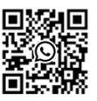
v1
July 2025
 | MON | TUE | WED | THURS | FRI | SAT
0700-0800 | 0700 Studio Pilates w/ Lizzie No class July 14th and 21st |  | 0700 Reformer Pilates w/ Lizzie (Pilates Studio) No class No Class Jul 9th and 16th |  | The front desk will be closed On July 4th. Happy Independence day!
0900 | Are you Certified in any Fitness Center Services? Contact us at 634 4472 or 0444-714472 |  | 0900 Reformer Pilates w/ Lizzie (Pilates Studio) No Class Jul 9th and 16th 0915-1015 SLAM (B-Ball / Track) | 0915-1015SLAM (B-Ball / Track) | SLAM 9:15-1015 (B-Ball / Track)
1000 | 1000-1100 Zumba w/ Charmaine GF1 Room | 1100 Fit Yoga FREE w/Raluca 45 Min (GF1) No classes July 1st and 29th | 1000-1100 Zumba w/ Charmaine GF1 Room |  |  | ^{New!!!} ¹²⁰⁰⁻¹³⁰⁰ ^{Free Hybrid Traning} ^{with Ambra} ^{Functional Room} ^{19 and 26 July only}
1200-1500 | 1200-1300 w/Alessandra Cardio Strength GF1 No Class July 28th | 1200 Kettlebell w/ Isabella (GF1) 1200-1300 Free Hybrid Traning with Ambra Functional Room No class 15 July | 1200-1300 w/Alessandra Cardio Strength GF1 | 1200 Kettlebell w/ Isabella (GF1) Fitness Center Hours Access 24/7 Front Desk Mon-Fri 0530-2000 Saturday 0900-1700 Sunday 1000-1700 Federal Holidays Closed Phone # 0444 714467 DSN 646 4467 | 1200-1300 w/Alessandra Cardio Strength GF1 No Class July 4th | Get your private locker for only $15 per month. See front desk for more info
1600-1800 | 1630 Springboard Pilates (Pilates Studio w/ Lizzie) No class Jul14th and 21st 1730 Studio Pilates w/ Lizzie No class Jul14th and 21st | 1730 Zumba w/Michelle (GF1) Personal Training Services Barbara Todescato | 1630 Reformer Pilates w/ Lizzie (Pilates Studio) No class No Class Jul 9th and 16th 1730 Reformer Pilates w/ Lizzie (Pilates Studio) No class Jul 9th and 16th 1700 Align and Flow Yoga w/Regan (GF1) No class July 30th |  | Personal Training Services Martina Bedin
1800-2000 | 1800 Zumba *FREE* w/Sara (GF1) No class July 7th Karate 1800-1900 w/ Matthew Combatives Room | 1800-1945 Hip-Hop Step Aerobics W/Byron Canopy area | 1800 Zumba *FREE* w/Sara (GF1) ^{New!!!} 1800-1900 Free Hybrid Training with Ambra Functional Room 2 and 23 July only | 1800-1945 Hip-Hop Step Aerobics W/Byron Canopy area | Karate 18001900 With Matthew No class 4th of July | Personal Training Services Regan Shifflett
1730 Zumba
w/Michelle (GF1)

